Slide 1
Lists: indexing and slicing.
Week 7 | Lecture 1 (7.1)
While waiting, open the Jupyter Notebook for today’s lecture
Upcoming.
Lab 5 Released Thursday 6:00 pm.
Reflection 7 Released Friday 6:00 pm.
Tutorial (in-person AND online) running all week.
Practical sessions (in-person AND online) running ONLY Friday this week.

Slide 2
This Week’s Content
Lecture 7.1
Lists: indexing and slicing
Lecture 7.2
Lists: nested lists and looping
Lecture 7.3
Design Problem! Connect 4

Slide 3


But First! The Midterm…

Slide 4
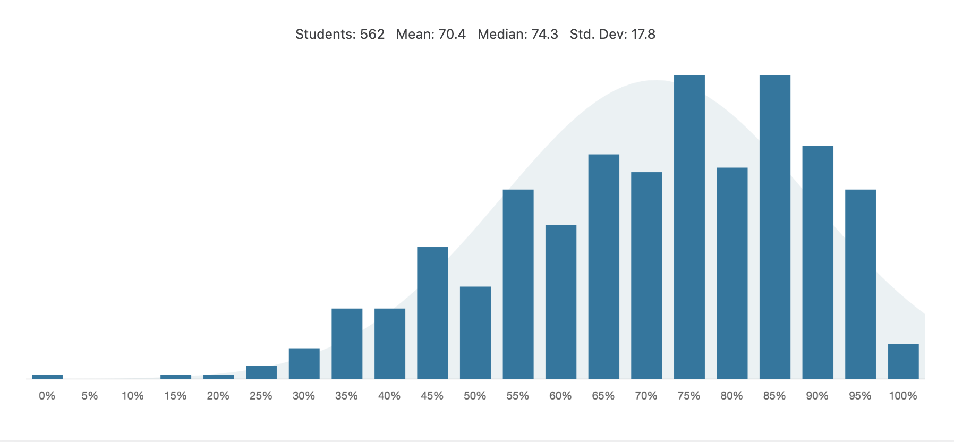
Midterm 1

Slide 5
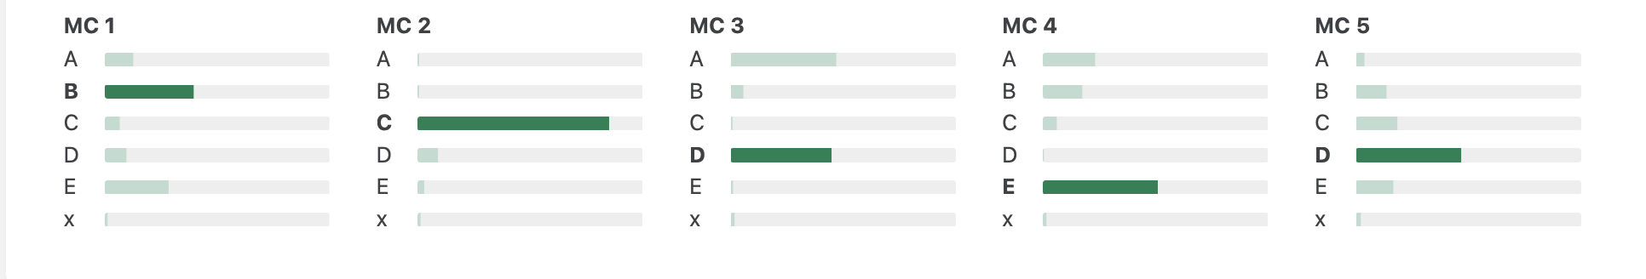
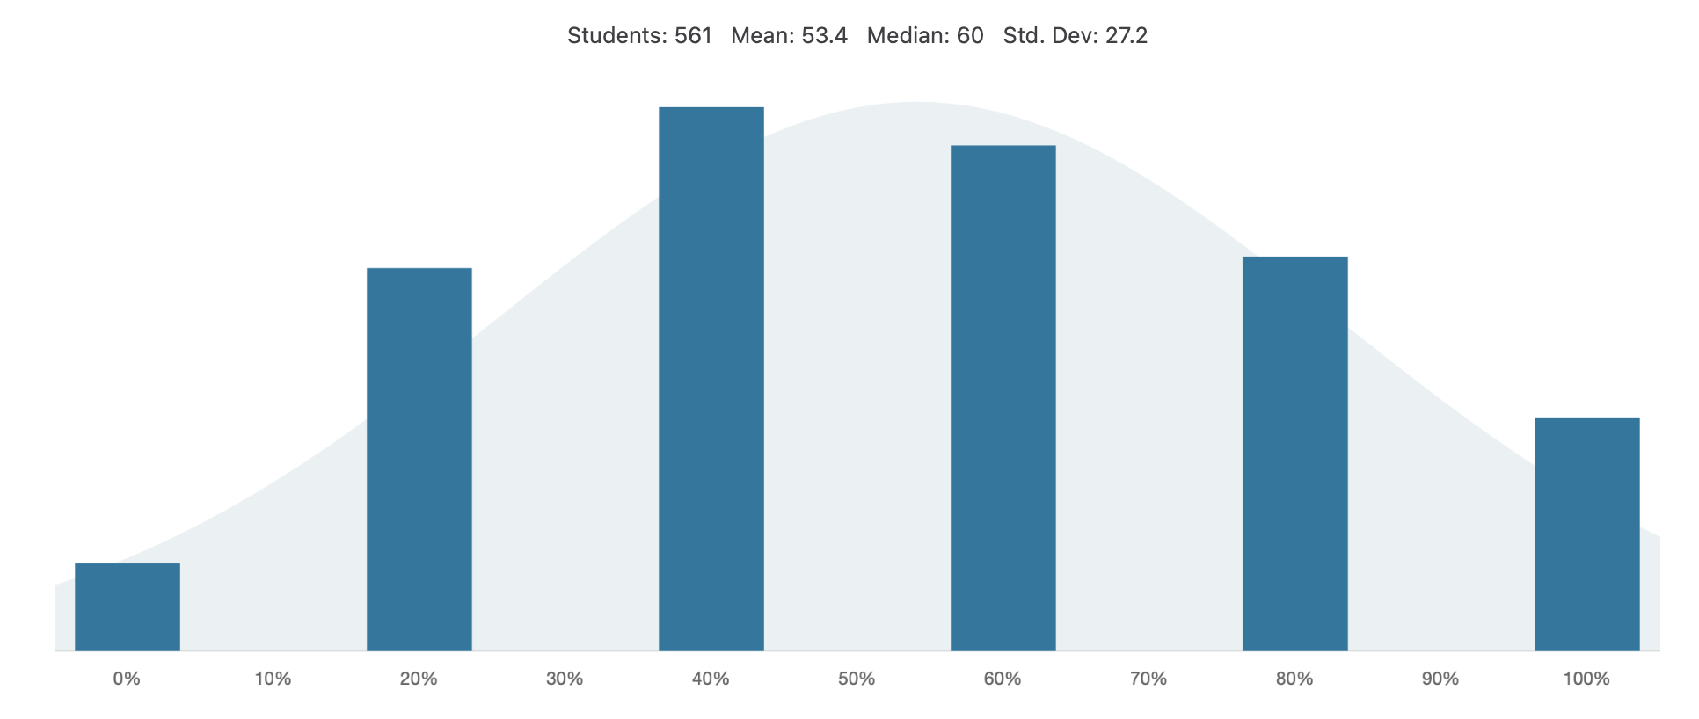
Question 1

Slide 6
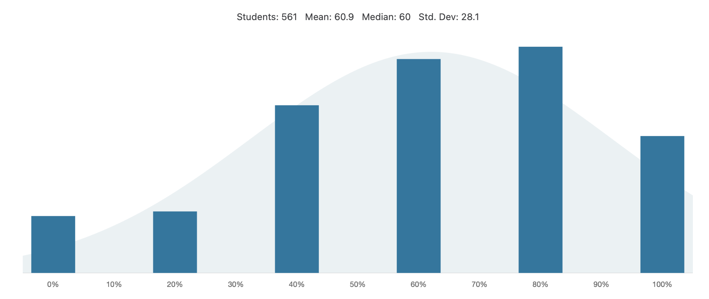
Question 2

Slide 7
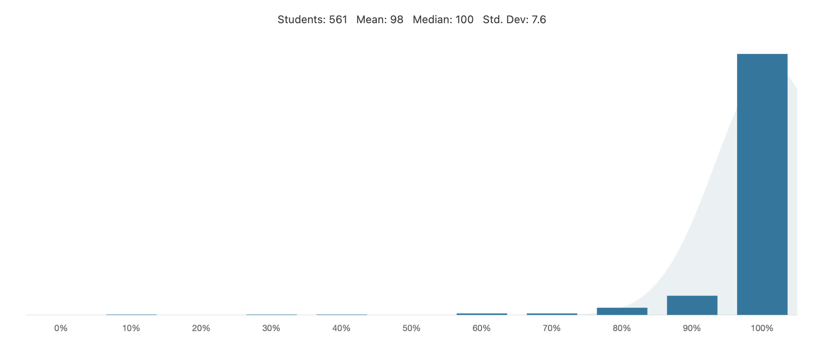
Question 3

Slide 8
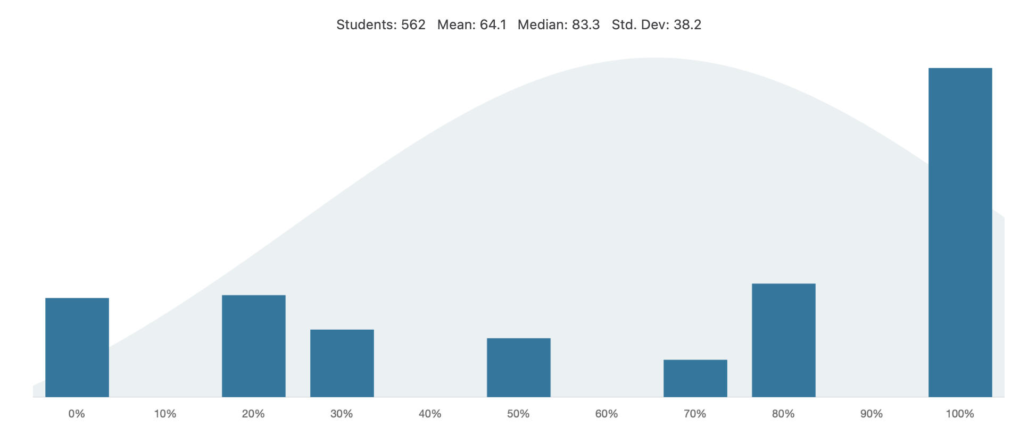
Question 4 a)

Slide 9
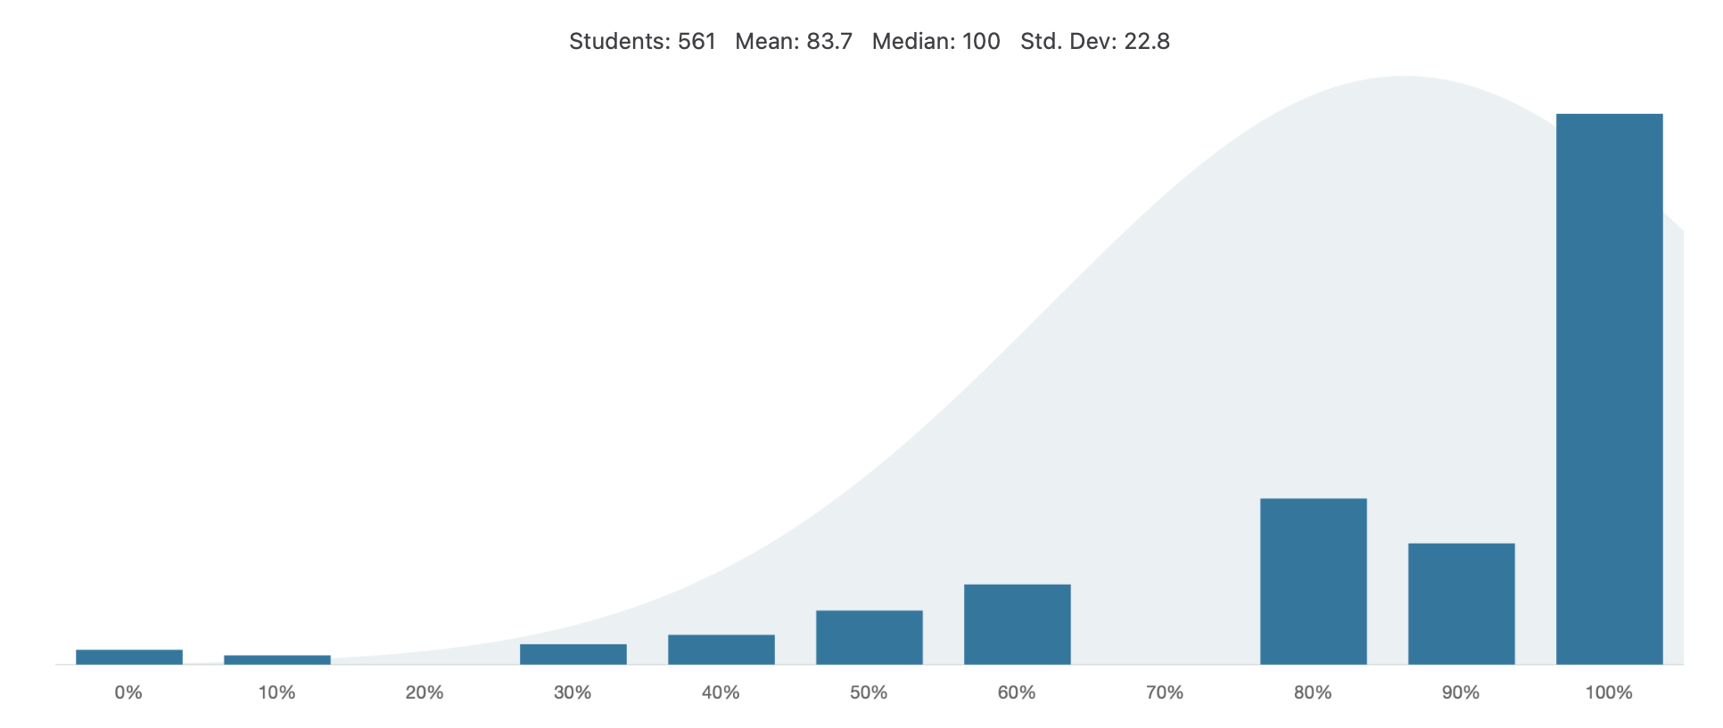
Question 4 b)

Slide 10
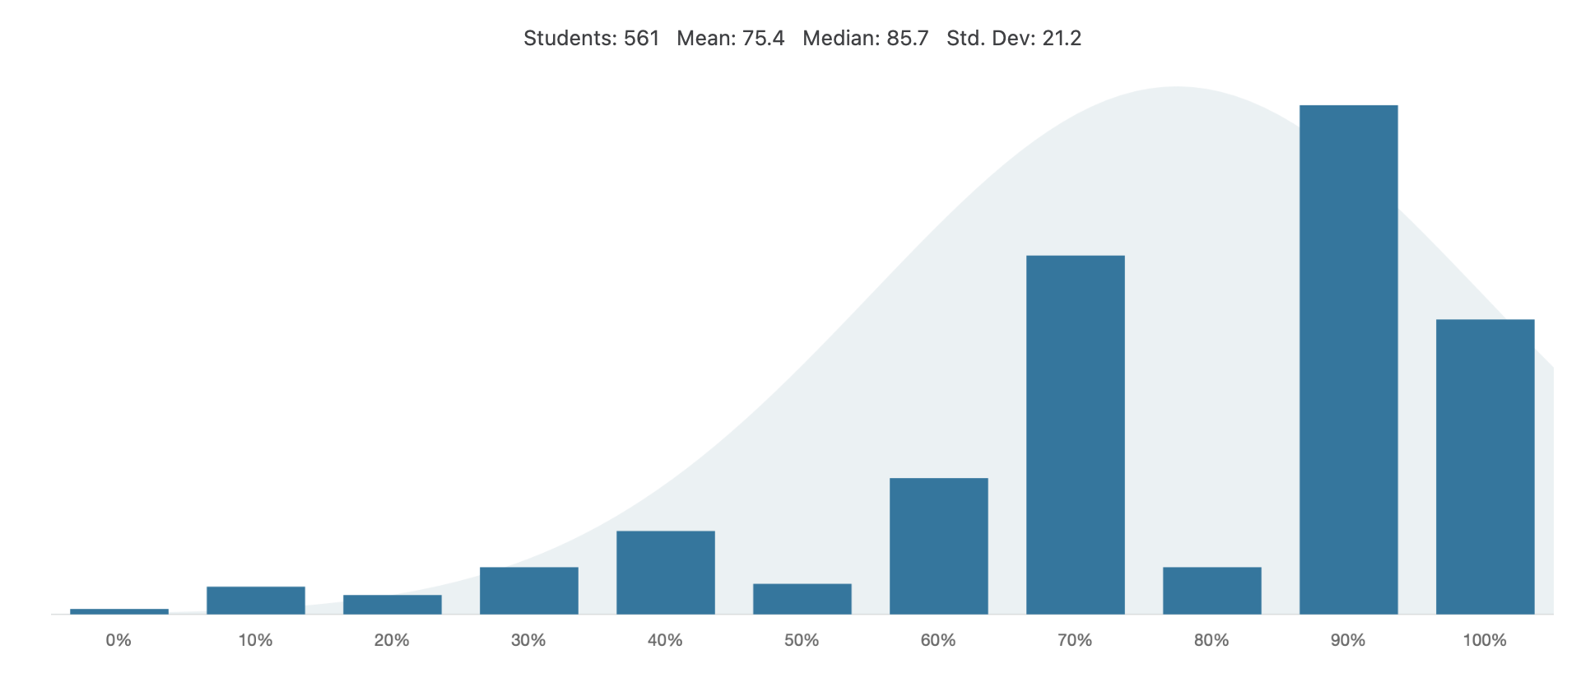
Question 5 a)

Slide 11
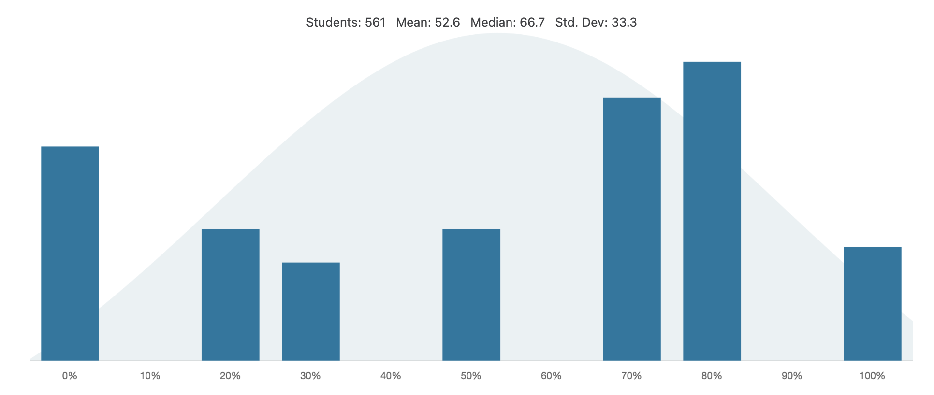
Question 5 b)

Slide 12

Online Tutorial
These times worked best for you!
TIP FOR SUCCESS: Put these in your calendar! Labs are due Friday night!
Schedule and Zoom Links are on Quercus
“Tutorial Homepage”
Commuting
 | Time
Tutorial | Wednesday 7 – 8 PM
Online Tutorials

Slide 13

Coffee Break with a TA!
Extra help hours!
TIP FOR SUCCESS: Put in calendar, treat as a scheduled class
Schedule and Zoom Links are on Quercus
”Coffee Break (Office Hours)”
Office Hours
Teaching Team | Time | Mode
Ben & Seb | Fridays 2 - 3 PM | MY765
Michael Tisi | Fridays 10 - 11 AM | Online
Thomas Pruyn | Mondays 3-4 PM | WB255 and Online
Mo Saneii | Tuesdays 3 - 4 PM | Online
Rachel Leung | Wednesdays 2-3PM | GB144 and Online
Hosein Seyed Ghafouri | Mondays 5 - 6 PM | Online
Coffee Break

Slide 14


Next Midterm: March 18
TLDL: Be like Gandalf, not Austin Powers

Slide 15

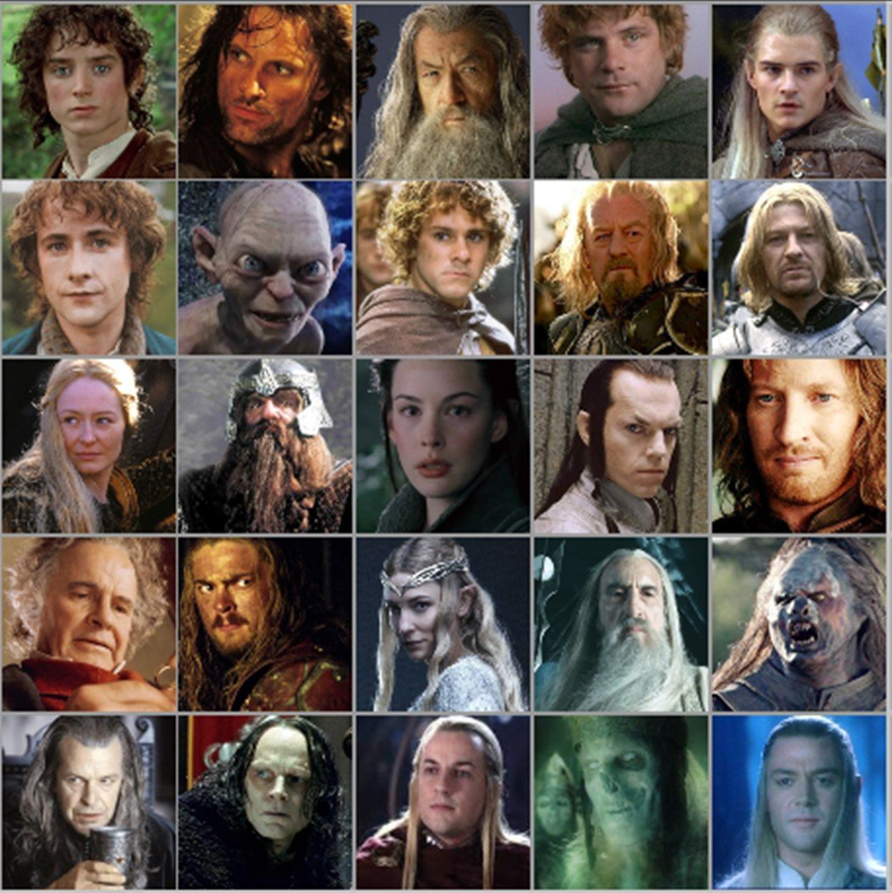


Motivation
We want to keep track of characters in a complex show/book
Name
Actor
Personality
Age
Title/Powers
We could store values in a string?
We could have unique variable names for each person?
gandalf_age = 24000
frodo = ”Frodo-Elijah Wood-brave, observant, and unfailingly polite-51-Ring bearer"
We need an efficient way to do this.

Slide 16
Motivation
We could store values in a string or other individual variables?
gandalf_name = ”Gandalf the Grey”
gandalf_age = 24000
#all other values for Gandalf in separate variables
We could have unique variable names for each person, including name, actor, personality, age and power?
frodo = ”Frodo-Elijah Wood-brave, observant, and unfailingly polite-51-Ring bearer”
#we could use frodo.split(‘-’) or frodo.find(‘-’) to split at or find the dashes
We need a more efficient way to do this

Slide 17
One way: Tables or Lists!
Name | Actor | Personality | Age | Powers
Sam
Frodo
Gandalf
Galadriel
Pippin
Aragorn
Legolas
Eowyn
Gollum
Arwen
Merry
Need to:
Create rows of data
Create columns of data
Be able to access a specific cell/index

Slide 18

Data Structures!
Data structures are “containers” that organize and group data
Lists
Sets
Tuples
Dictionaries
Custom classes/objects
Linked lists
Binary trees
Stacks
Queues
Arrays
Heaps

Slide 19

Type: List
Can store an ordered collection of data using Python’s type list
The general form of a list is:
Values are enclosed in ([ ]) and separated by commas (,)
Can assign lists to a variable name:
[val1, val2, val3, …, valN]
my_list = [val1, val2, val3, …, valN]

Slide 20
List Elements
list elements can be of any type:
A list can contain elements of more than one type:
subjects = [‘bio’, ‘programming’, ‘math’, ‘history’]
grades = [75, 98, 82, 62]
street_address = [10, ‘Main Street’]
light = [‘status’, True, ‘intensity’, 3.1]

Slide 21
List Operations (Indexing and Slicing)
A list can be indexed just like a string:
A list can be sliced just like a string:
>>> grades = [80, 90, 70, 45, 98, 57]
>>> grades[1]
90
>>> grades[-3]
45
>>> grades[0:2] [80, 90]
>>> grades[::-2] [57, 45, 90]

Slide 22

Nested Lists
Lists can contain any type, including other lists!
Called “nested lists”
To access a nested item, first select the sublist, then treat as a regular list
[list1, list2, …, listN]
[val1, val2, …, valN]
>>> list_of_lists[0]
[val1, val2, …, valN]
>>> list_of_lists[0][1]
val2

Slide 23
Nested Lists Example
Let’s provide some information in our list of grades:
Now we can access different parts depending on what we want:
>>> aps106_grades = [[‘Midterm 1’, 60],[‘Midterm 2’, 90],[‘Exam’, 100]]
>>> aps106_grades = [[‘Midterm 1’, 60],
[‘Midterm 2’, 90],
[‘Exam’, 100]]
BOTH OF THESE ARE THE SAME THING!
>>> aps106_grades[0]
[‘Midterm 1’, 60]
>>> aps106_grades[2][1]
100

Slide 24
Let’s Code!
Let’s take a look at how this works in Python!
Creating lists
List indexing and slicing
List operations
Nested lists!
Open your notebook
Click Link:
1. The ‘list’ Type

Slide 25
List Mutability
Lists are mutable!
This means they can be mutated (modified)
All the other types we’ve learned so far (string, int, float, and bool) are immutable (i.e. they can NOT be modified)

Slide 26
List Mutability Example
>>> s = “I love cats”
s[0] = “U”
Traceback (most recent call last):
builtins.TypeError: 'str' object does not support item assignment
>>> grades = [80, 90, 70, 45, 98, 57]
>>> grades[3] = 100
>>> grades[-1] = 100
>>> grades[2] = ‘Perfect’
>>> grades
[80, 90, ‘Perfect’, 100, 98, 100]
strings are immutable
lists are mutable

Slide 27
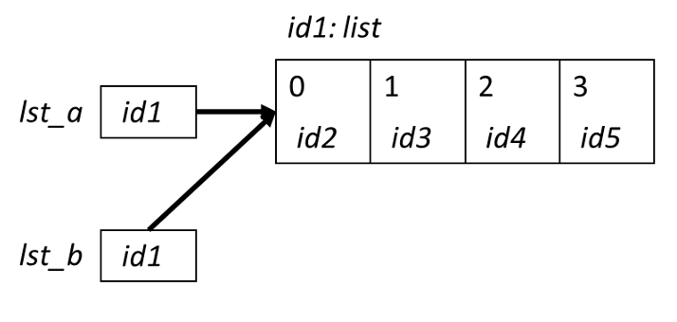


Aliasing
When two variable names refer to the same object, they are aliases.
When we modify one variable, we are modifying the object it refers to, hence also modifying the second variable.
This is common source of error when working with list objects.

Slide 28
Aliasing Example (with Visualizer)
Permalink:
https://tinyurl.com/aps106alias

Slide 29
Avoiding Aliasing
>>> lst1 = [11, 12, 13, 14, 15, 16, 27]
>>> lst2 = lst1
>>> lst1[-1] = 17
>>> lst2
[11, 12, 13, 14, 15, 16, 17]
>>> id(lst1)
49012568
>>> id(lst2)
49012568
How can we copy lst1 into another list without aliasing?

Slide 30
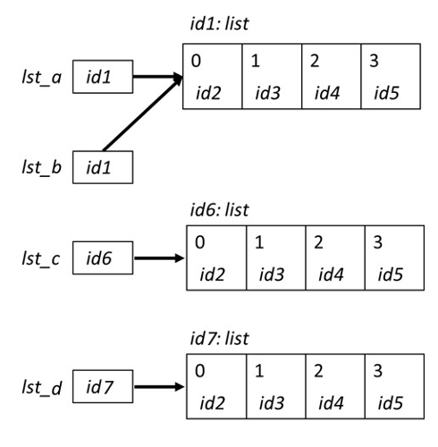
Copying Lists and Avoiding Aliasing
There are two simple ways to copy lists:
Using the list( ) function
Completely slice the list [:]
>>> lst_a = [0, 1, 2, 3]
>>> lst_b = lst_a
>>> lst_c = list(lst_a)
>>> lst_d = lst_a[:]
>>> id(lst_a)
39012510
>>> id(lst_b)
39012510
>>> id(lst_c)
54514112
>>> id(lst_d)
24514139

Slide 31
Avoiding Aliasing Example (with Visualizer)
Permalink:
https://tinyurl.com/aps106alias2

Slide 32
Let’s Code!
Let’s take a look at how this works in Python!
List mutability
Aliasing
Copying lists
Open your notebook
Click Link:
2. Mutability and Aliasing

Slide 33
Built-in Functions
Several of Python's built-in functions can be applied to lists, including:
len(list) : return the number of elements in list (i.e. the length)
min(list) : return the value of the smallest element in list.
max(list) : return the value of the largest element in list.
sum(list) : return the sum of elements of list (list items must be numeric).

Slide 34
List Methods
Lists are objects and just like other objects, the list type has associated methods that are only valid for lists
Recall you can find out which methods are associated with objects using the built-in function dir
>>> dir(list)
['__add__', '__class__', '__class_getitem__', '__contains__', '__delattr__', '__delitem__', '__dir__', '__doc__', '__eq__', '__format__', '__ge__', '__getattribute__', '__getitem__', '__gt__', '__hash__', '__iadd__', '__imul__', '__init__', '__init_subclass__', '__iter__', '__le__', '__len__', '__lt__', '__mul__', '__ne__', '__new__', '__reduce__', '__reduce_ex__', '__repr__', '__reversed__', '__rmul__', '__setattr__', '__setitem__', '__sizeof__', '__str__', '__subclasshook__', 'append', 'clear', 'copy', 'count', 'extend', 'index', 'insert', 'pop', 'remove', 'reverse', 'sort']

Slide 35
Adding Items to a List
To add an object to the end of a list, use the list method append:
To add a list to the end of a list, use the list method extend:
>>> colours = ['blue', 'yellow’] >>> colours.append('brown’) >>> colours ['blue', 'yellow', 'brown']
>>> colours = ['blue', 'yellow’] >>> colours.extend([‘pink’,‘green’]) >>> colours ['blue', 'yellow', ‘pink’, ‘green’]

Slide 36
Removing Items from a List
To remove an object from a list, use the list method remove:
How can we write it so there’s no error?
>>> colours = ['blue', 'yellow’, ‘pink’] >>> colours.remove(‘yellow’) >>> colours ['blue', ‘pink’]
>>> colours.remove(‘red’)
Traceback (most recent call last):
builtins.ValueError: list.remove(x): x not in list

Slide 37
Is something in my list?
The in operator can be used on lists too!
colours = ['blue', 'yellow’, ‘pink’]
if ‘red’ in colours:
colours.remove(‘red’)

Slide 38
Let’s Code!
Let’s take a look at how this works in Python!
Open your notebook
Click Link:
3. List Methods

Slide 39


Mentimeter Checkpoint
Join at www.menti.com:
Code: 1893 7870
Link
https://www.menti.com/alcdc2vk9yen

Slide 40
Lists: indexing and slicing.
Week 7 | Lecture 1 (7.1)

